Slide 1
HeartWatch: AFib Monitoring
CONTINUE
Brian Ngo, Ammar Khakoo, Desmond Patrick Bolia, Yuxuan Lu

Slide 2
1
What is AFiB?
PREV
NEXT
Atrial fibrillation (AFib) is an increasingly common heart condition that primarily affects older adults and individuals with cardiovascular risk factors.

Slide 3
INTRODUCTION
PREV
NEXT
AFib is characterized by an irregular and often rapid heart rhythm, which leads to the chaotic beating of the atria (upper heart chambers).
This irregular rhythm can result in blood clots forming in the heart, potentially leading to stroke, heart failure, and other serious heart-related complications.

Slide 4
Challenges
PREV
NEXT
More Cases Than Expected
A Study in 2024 shows that AFib is three times more common than previously estimated, now affecting 10.5 million Americans, or nearly 5% of the population.
Challenges in Managing AFib in Patients
Challenges include difficulty detecting irregular rhythms in daily life, managing associated risk factors like hypertension and obesity, and ensuring timely responses to abnormal heart activity.
The current solution for AFib analysis is laborious. An EKG reading is given and is hard to understand for the average AFib patient so they would need a healthcare provider to help decipher.
https://www.ucsf.edu/news/2024/09/428416/how-many-people-have-fib-three-times-more-we-thought

Slide 5
Our Solution
HeartWatch is a Software as a Medical Device (SaMD) that provides continuous AFib monitoring through smartwatches. It uses AI-driven analysis of heart rate, rhythm, and blood oxygen data to detect irregularities and guide users in managing their condition proactively. Early detection and continuous monitoring can significantly reduce the risks of stroke and heart failure.
HeartWatch leverages data sharing networks and machine learning to provide real-time insights on AFib symptoms. It integrates seamlessly with popular wearables like Apple Watch and Fitbit, empowering users to monitor and manage their cardiovascular health from anywhere.

Slide 6
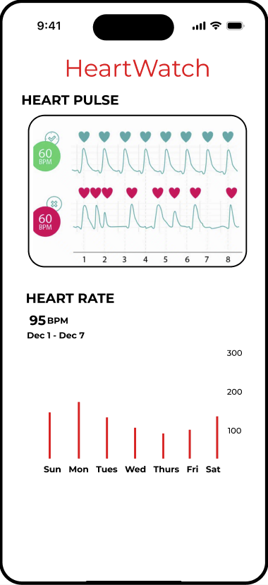
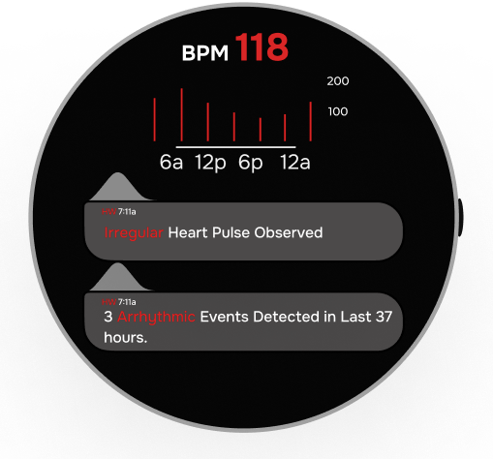
Key Features of the Application
Alerts users to abnormal vitals indicative of AFib episodes or atypical symptoms.
Real-Time Alerts and Reminders
Organizes and presents detailed health data for review by users and healthcare providers.
Detailed Data Analysis
Tracks heart rate, heart pulse, and blood oxygen levels via PPG sensors for immediate tracking, and trend data.
Vital Sign Monitoring
HeartWatch UI on a Google Pixel Watch (left) and iPhone (right)

Slide 7
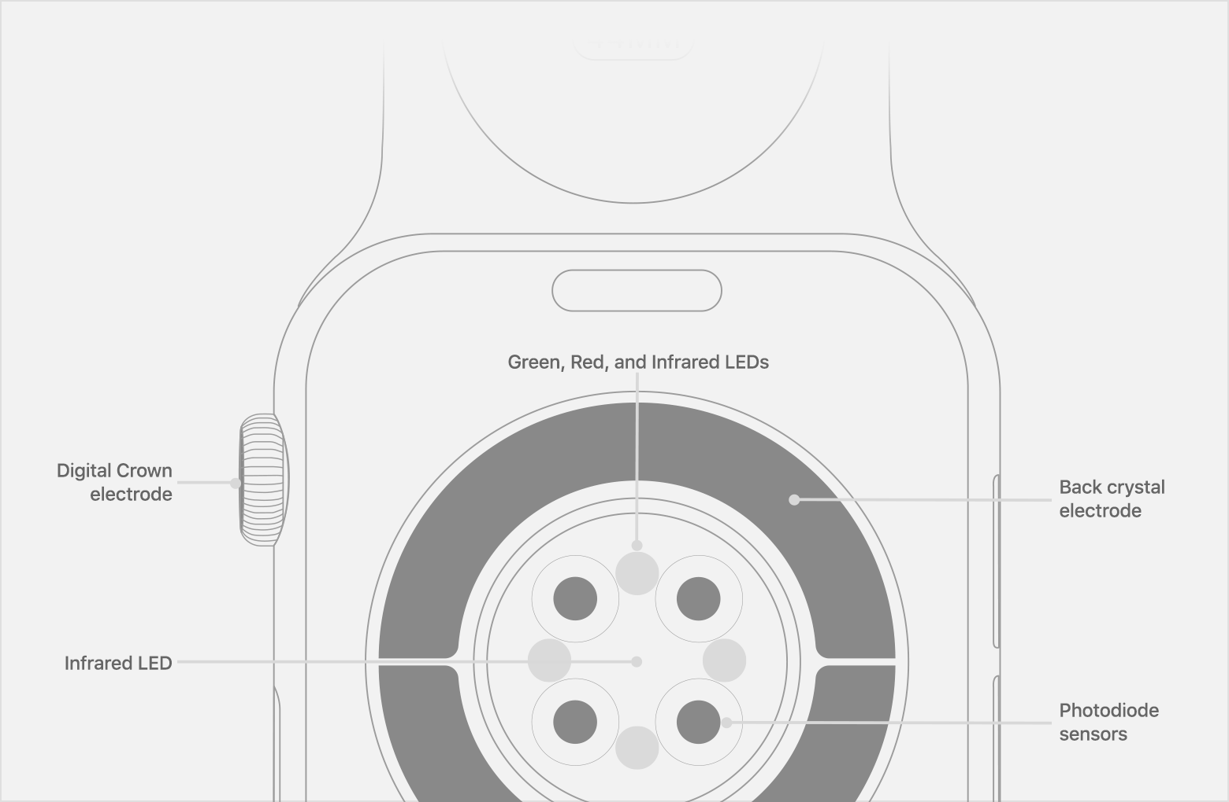
How HeartWatch Works
HeartWatch leverages photoplethysmogram (PPG) sensors common in virtually all wearables.
PPG sensors measure blood volume below the skin to create electrical signals that can be analyzed.
PPG detail drawing - Apple Watch

Slide 8
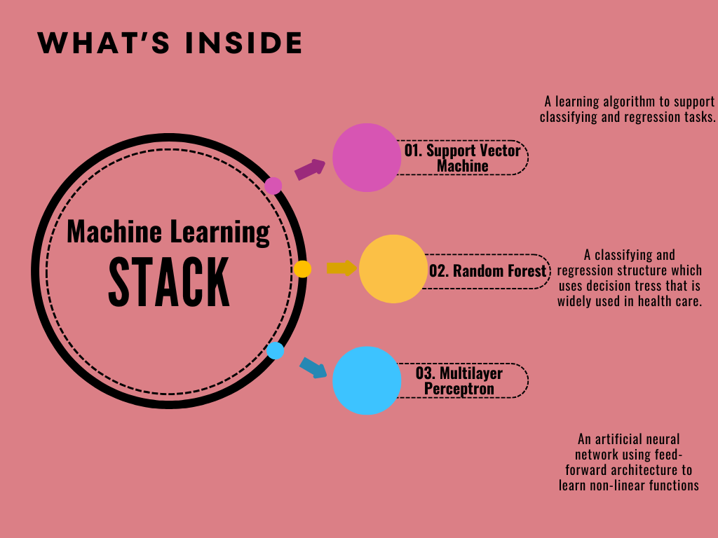
Synthesizing PPG Data via Machine Learning

Slide 9
Model Accuracy
SVM
.9528 Accuracy
STACK
.9768 Accuracy
MLP
.9518
Accuracy
RF
.9407
Accuracy
When applied to PPG sensor data, these stacked models achieve an accuracy score of .9768 and an AUC score of .99

Slide 10
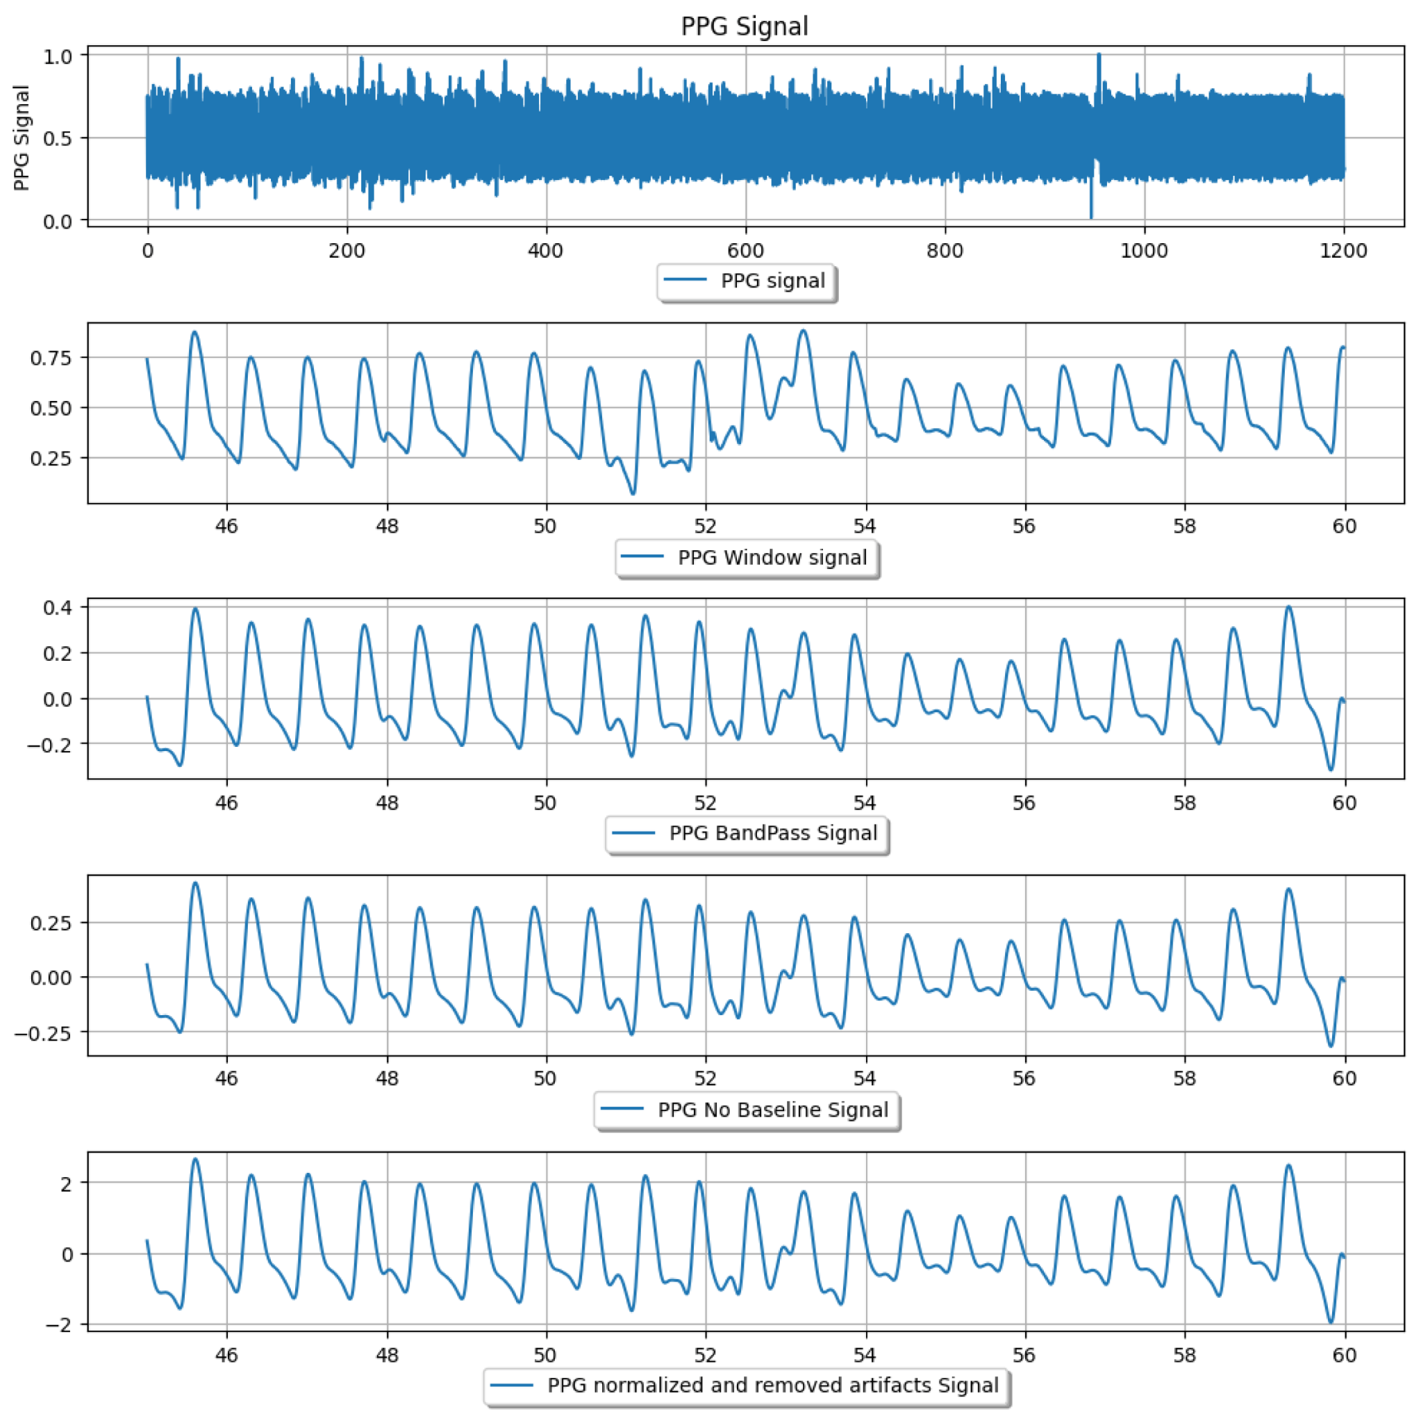
Data Processing Example
From Preprocessed Data to Analyzable Information
Raw Data is refined, then analyzed through ML stack.
This data is used to create ECG data and measure it against control subjects with healthy cardiovascular activity.
It is then organized and stored for use by patients and clinicians.
Preprocessing pipeline for PPG data

Slide 11
Target Demographic
Users diagnosed with Afib
The Journal of the American College of Cardiology estimates “that the current national prevalence of diagnosed AF is at least 10.55 million”
A previous study projected that there would be 3.3 million adults with AF in the United States in 2020
“Over time, AF patients became relatively younger, were less likely to be female or White, and were more likely to have hypertension and diabetes.”
Users with heart conditions that may be correlated with Afib, to track and monitor heart health for Afib symptoms.

Slide 12
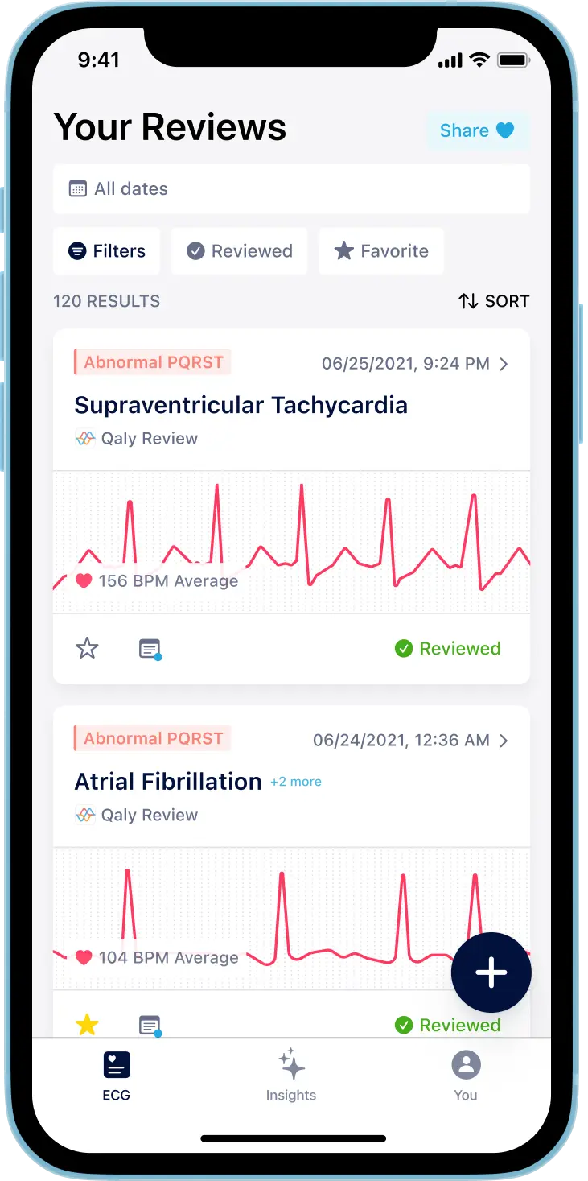
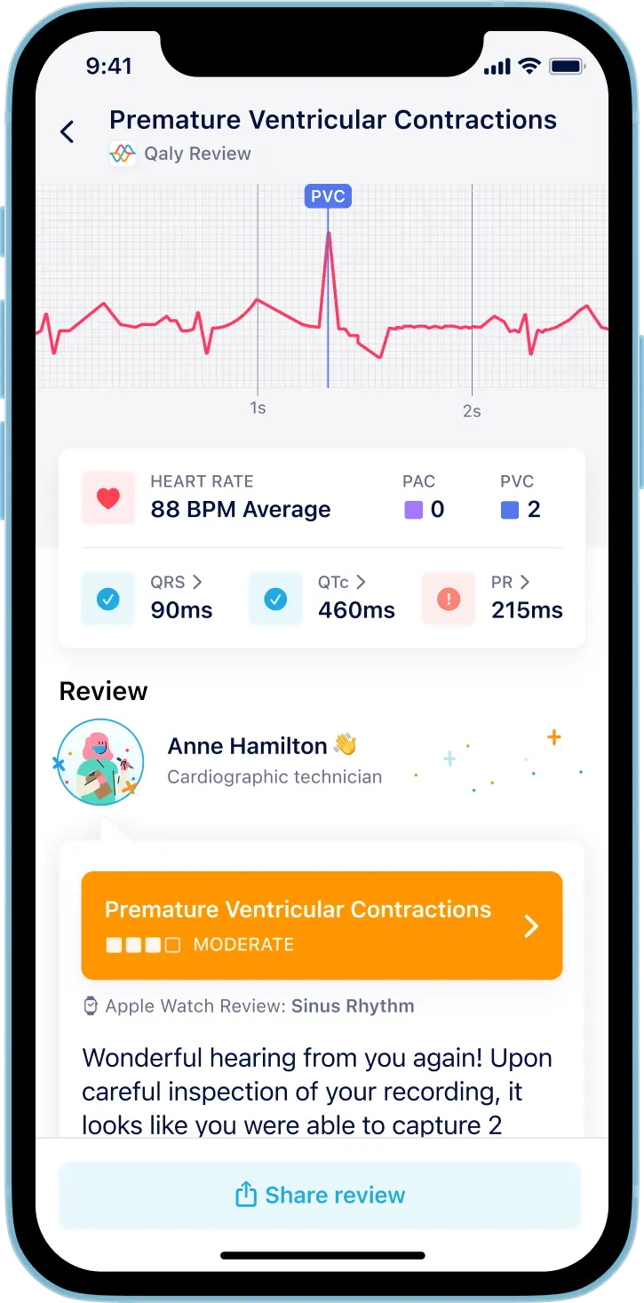
Qaly App
PREV
NEXT
Features
Compatible with any wearable
Tracks history of ECG Readings
Certified professional analysis of ECG
Drawbacks
$30/month
Long turnaround time for professional insight

Slide 13
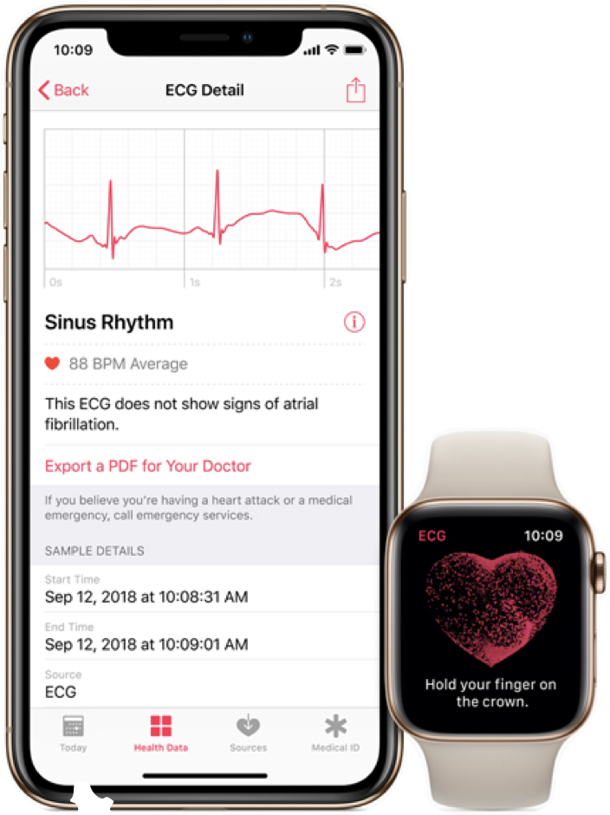
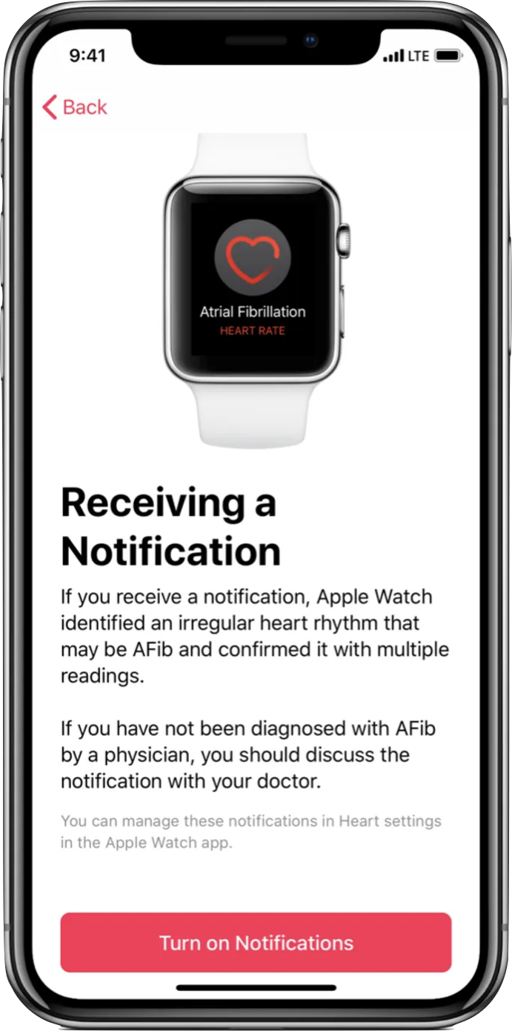
Apple Medication
PREV
NEXT
Features
Tracks heart rate and ECG
Instant interpretation on vitals
Automatic irregular heartbeat notifications
Drawbacks
Only on IOS
Only works with Apple Watch

Slide 14
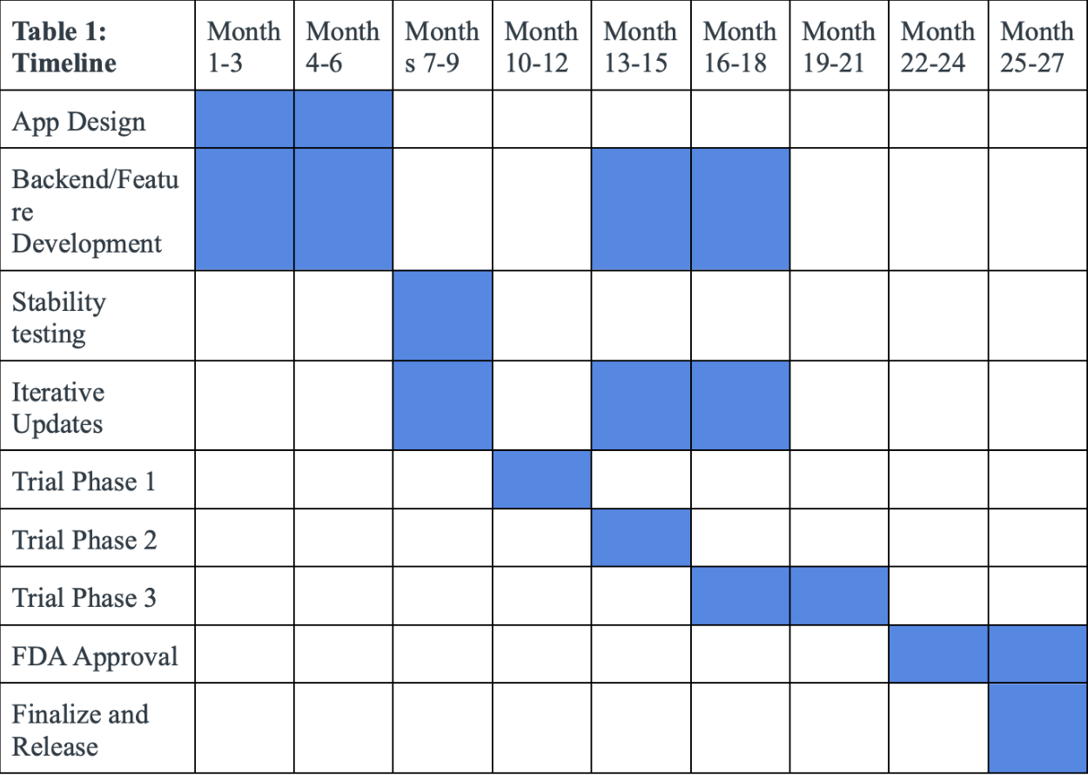
Timeline
PREV
NEXT
27 Months to develop app
Part 1: App groundwork and feature development
Part 2: Clinical Trials and iterative updates

Slide 15
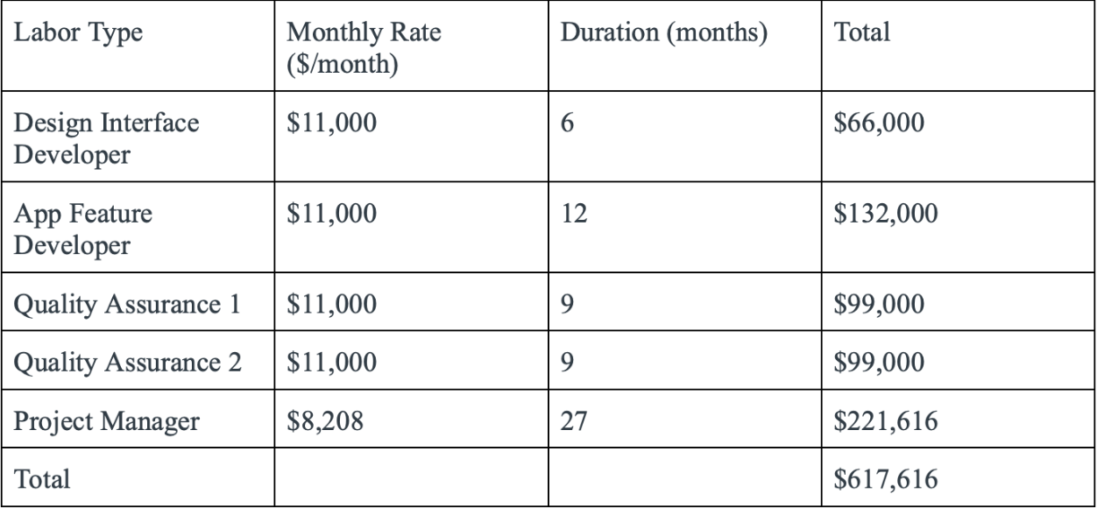
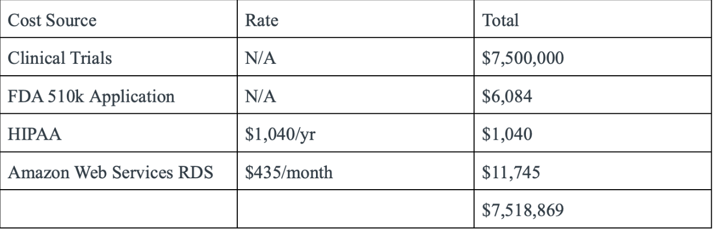
Costs
PREV
NEXT
Total Cost - $8,136,485
Labor
Clinical Trials
FDA, HIPAA clearance
Server Hosting

Slide 16
Risk Management
1. Undetected AFib Events
Alerts reach both users and caregivers
2. Overdependence
Collaboration with health providers
Notify hospitals if regular check-ups missed
3. Data Security
Strong password protection
Safe data storage solution (Amazon RDS)
User control over data (local or cloud)
Education on privacy

Slide 17
Conclusion
HeartWatch aims to address the growing challenge of managing AFib, particularly those at risk of severe heart complications.
Heartwatch integrates seamlessly with existing wearable devices, using advanced machine learning to detect irregularities in cardiovascular health.
Heartwatch’s goal is to improve health outcomes, reduce healthcare burdens, and provide a user-friendly means for managing AFib effectively.

Slide 18
References
[1]Brian, “What You Don’t Know About Your Meds Can Kill You | Medisafe,” Medisafe, Oct. 10, 2018. https://www.medisafe.com/what-you-dont-know-about-your-meds-can-kill-you/ (accessed Nov. 06, 2024).
‌[2]“Track your medications in Health on iPhone,” Apple Support, 2024. https://support.apple.com/guide/iphone/track-your-medications-iph811670c81/ios (accessed Nov. 06, 2024).
[3] B. P. Krijthe, A. Kunst, E. J. Benjamin, G. Y. H. Lip, O. H. Franco, A. Hofman, J. C. M. Witteman, B. H. Stricker, and J. Heeringa, "Projections on the number of individuals with atrial fibrillation in the European Union, from 2000 to 2060," Eur. Heart J., vol. 34, pp. 2746-2751, 2013.
[4] E. J. Benjamin, P. A. Wolf, R. B. D’Agostino, H. Silbershatz, W. B. Kannel, and D. Levy, "Impact of Atrial Fibrillation on the Risk of Death," Circulation, vol. 98, no. 10, pp. 946-952, Sep. 1998.
[5] S. J. Czaja et al., "Factors Predicting the Use of Technology: Findings from the Center for Research and Education on Aging and Technology Enhancement (CREATE)," Psychology and Aging, vol. 21, no. 2, pp. 333–352, 2006.
[6] K.-J. Brickwood, A. D. Williams, G. Watson, and J. O’Brien, "Older adults' experiences of using a wearable activity tracker with health professional feedback over a 12-month randomized controlled trial," Digital Health, vol. 6, pp. 1-13, 2020.
[7] P. A. Williams and V. McCauley, "Always Connected: The Security Challenges of the Healthcare Internet of Things," Journal of Medical Internet Research, vol. 18, no. 6, 2016.

